Slide 1
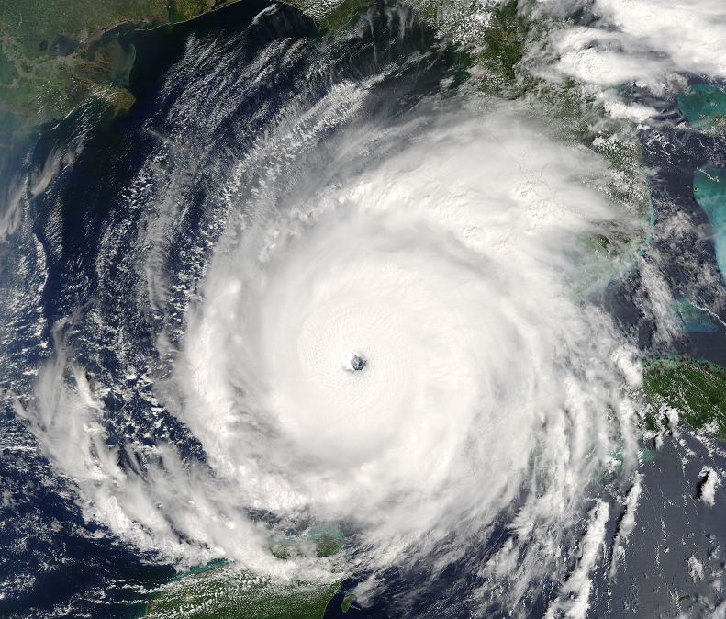


Examining the Impact of Stratiform Rainband Heating on TC Structure using Idealized Simulations
Chris Yu and Anthony C. Didlake, Jr.
Pennsylvania State University
May 22th, 2018
Hurricane Rita 2005

Slide 2
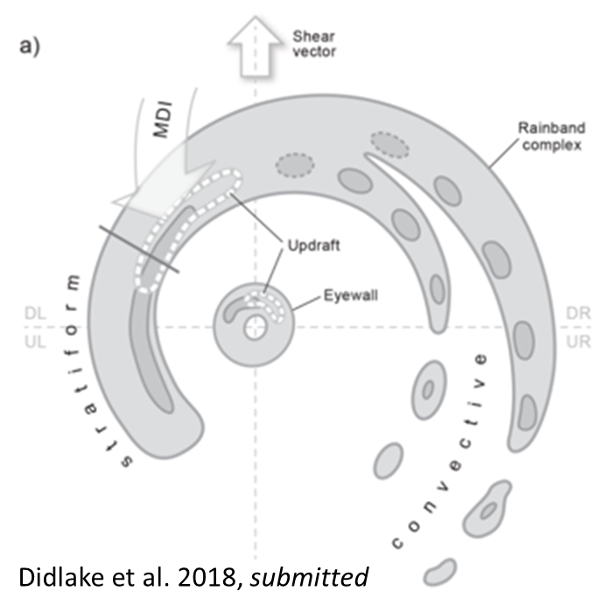
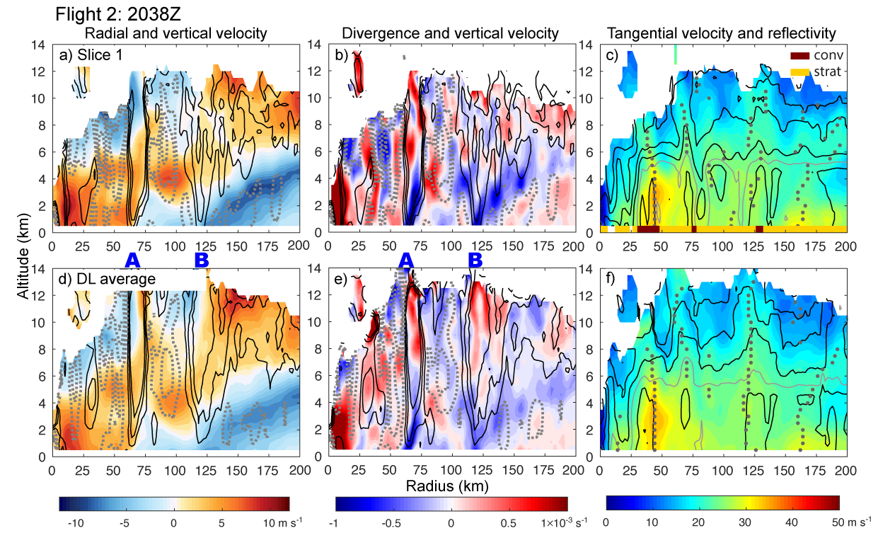
What do we know about stratiform rainband?
Hurricane Earl 2010
Contour: W Shading: U
10
5
0
-5
10
Stratiform rainband in the left-of-shear quadrants
Mesoscale descending inflow (MDI) in downshear left (DL) quadrant driven by stratiform heating/cooling distributions, leading to enhanced updraft and tangential wind field
Goal: We want to use idealized modeling of a TC vortex to examine the quasi-steady-state one-way response of wind and pressure fields to a stratiform heating and cooling.
Notes:
Changes: In, left-of-shear, mesoscale, DL, quasi-steady-state

Slide 3
What do we know about stratiform rainband?
Hurricane Earl 2010
Contour: W Shading: U
10
5
0
-5
10
Stratiform rainband in the left-of-shear quadrants
Mesoscale descending inflow (MDI) in downshear left (DL) quadrant driven by stratiform heating/cooling distributions, leading to enhanced updraft and tangential wind field
Goal: We want to use idealized modeling of a TC vortex to examine the quasi-steady-state one-way response of wind and pressure fields to a stratiform heating and cooling.

Slide 4
Model and Experiment Setup
WRF-ARW in resolutions of 1, 3 and 9 km
Dry atmosphere with No parameterization (microphysics, cumulus, boundary layer)
Stationary heating region
Heating and Cooling [Kh⁻¹]
Moon and Nolan (2010)
Heating spatial coverage
Tangential wind profile
0 ºC

Slide 5
Re-examine Moon and Nolan 2010 stratiform heating profile
Axisymmetric wind field response
Heating and Cooling [Kh⁻¹]
Shading: Tangential Wind Response; Vector: (U, W)
z [km]
0 ºC
Our simulation
Moon and Nolan 2010
Notes:
Title: Axisymmetric wind field response

Slide 6

Heating Profile (Shading)
Height level (Red line)
Shading: W Response; Vector: (U, V)
Our Simulation
Moon and Nolan 2010
Z = 3.6km
Z = 2km
Notes:
Cover b and c
Height level (Red line)

Slide 7
A forced updraft
Tangential Wind Response (shading); Vector: (U, W)
w’ at 2 km
Our Simulation
Moon and Nolan 2010
A
z [km]
B
A
r [km]
B

Slide 8
A forced updraft
Tangential Wind Response (shading); Vector: (U, W)
Hurricane Earl cross section
Our Simulation
Moon and Nolan 2010
10
5
0
-5
10
z [km]
A
r [km]
B

Slide 9

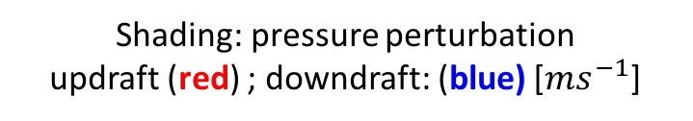

A forced updraft
Shading: pressure perturbation
updraft (red) ; downdraft: (blue) [$ms^{−1}$]
Tangential Wind Response (shading); Vector: (U, W)
Our Simulation
Moon and Nolan 2010
z [km]
A
r [km]
B
A
r [km]
B
$$−p^{′}$$
$$\text{+}p′$$
Notes:
Units of wind field and pressure field.
+p’
-p’
What are the contours?

Slide 10
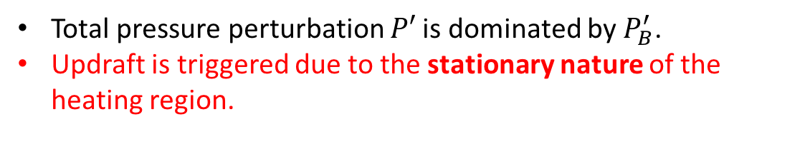



Decomposing Pressure Response
Houze (1993)
Total pressure perturbation $P′$ is dominated by $P_{B}^{′}$.
Updraft is triggered due to the stationary nature of the heating region.
$$∇^{2}P^{′}=\frac{∂}{∂z}\left(ρ_{0}B\right)−∇∙\left(ρ_{0}v∙∇v\right)$$
Laplacian of Pressure
$$\text{Buoyancy} \text{Pressure} \text{Forcing}$$
$$\text{Dynamic} \text{Pressure} \text{Forcing}$$

Slide 11
Decomposing Pressure Response
Houze (1993)
Question:
How would this updraft response be modified under a more realistic heating and cooling structure?
$$∇^{2}P^{′}=\frac{∂}{∂z}\left(ρ_{0}B\right)−∇∙\left(ρ_{0}v∙∇v\right)$$
Heating and Cooling [Kh⁻¹]
Laplacian of Pressure
$$\text{Buoyancy} \text{Pressure} \text{Forcing}$$
$$\text{Dynamic} \text{Pressure} \text{Forcing}$$
0 ºC

Slide 12
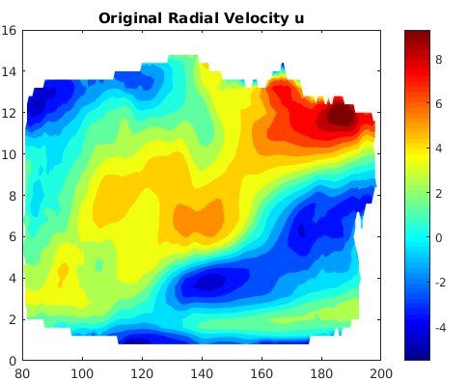
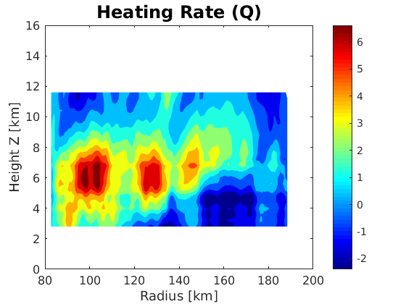
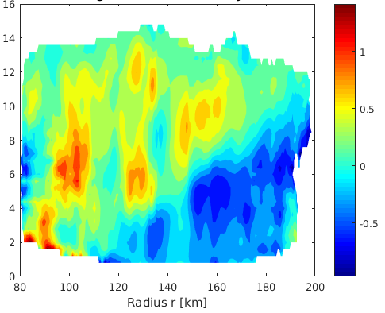

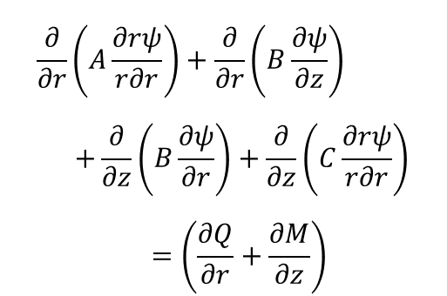
How does the heating and cooling structure within an observed hurricane stratiform rainband look?
Radial Velocity U
Sawyer Eliassen Equation
Reconstructed Heating $q [W]$
$$\frac{∂}{∂r}\left(A\frac{∂rψ}{r∂r}\right)+\frac{∂}{∂r}\left(B\frac{∂ψ}{∂z}\right) \\ +\frac{∂}{∂z}\left(B\frac{∂ψ}{∂r}\right)+\frac{∂}{∂z}\left(C\frac{∂rψ}{r∂r}\right) \\ =\left(\frac{∂Q}{∂r}+\frac{∂M}{∂z}\right)$$
Vertical Velocity W
A is static stability,
B is baroclinicity,
C is inertial stability

Slide 13
A modified diabatic heating consistent with observed secondary circulation
MN10 Stratiform
Modified stratiform heating

Slide 14

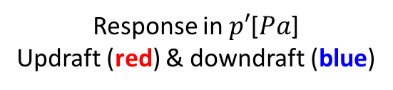
Vortex response to modified stratiform heating
Response in $p′$[$Pa$]
Updraft (red) & downdraft (blue)
w’ at 2km
Tangential Wind Response [$ms^{−1}$]
Z[km]
C
D
C
D
C
D
radius [km]
radius [km]
-4 -3 -2 -1 0 1 2 3 4
-80 -60 -40 -20 0 20 40 60 80
Notes:
Add w contour label

Slide 15
Vortex response to modified stratiform heating
Radial Velocity U
Response in $p′$[$Pa$]
Updraft (red) & downdraft (blue)
Tangential Wind Response [$ms^{−1}$]
Z[km]
Vertical Velocity W
C
D
C
D
radius [km]
radius [km]
-4 -3 -2 -1 0 1 2 3 4
-80 -60 -40 -20 0 20 40 60 80

Slide 16

Azimuthal Average Response
Tangential Wind Response [$ms^{−1}$]
Deeper layer of midlevel inflow
Forced upward motion more apparent in azimuthal average
Deeper layer of enhanced tangential winds
Potential impact on boundary layer:
Lower extent of enhanced tangential winds all the way into the lowest model levels
Modified stratiform heating
Z[km]
Moon and Nolan 2010 heating
Z[km]
radius [km]

Slide 17
Could this forced updraft trigger buoyant updraft?
Rerun the simulation with addition of moisture (RH ~ 90-95%)
No boundary layer scheme/surface layer scheme
No friction but has surface moisture and heat fluxes
Histogram of w > 0.5 m/s between hr 3 - 8
Qcloud > 0.0005 kg/kg between hr 3 - 8

Slide 18
Conclusions
With a stationary stratiform rainband heating, vortex response shows a strong forced updraft at inner radii consistent with observations, which potentially could trigger new buoyant updraft.
Using Sawyer Eliassen equation, a more realistic stratiform heating and cooling is reconstructed based on observed secondary circulation in Hurricane Rita 2005 (Didlake and Houze 2013).
With the modified stratiform heating profile, the overall response is a deeper layer of descending inflow and broader tangential wind enhancement, with stronger impact on boundary layer.

Slide 19
Conclusions
With a stationary stratiform rainband heating, vortex response shows a strong forced updraft at inner radii consistent with observations, which potentially could trigger new buoyant updraft.
Using Sawyer Eliassen equation, a more realistic stratiform heating and cooling is reconstructed based on observed secondary circulation in Hurricane Rita 2005 (Didlake and Houze 2013).
With the modified stratiform heating profile, the overall response is a deeper layer of descending inflow and broader tangential wind enhancement, with stronger impact on boundary layer.
Thank you! Questions?

Slide 20

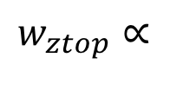

Azimuthal Average Response
Tangential Wind Response [$ms^{−1}$]
Deeper layer of midlevel inflow
Forced upward motion more apparent in azimuthal average
Deeper layer of enhanced tangential winds
Potential impact on boundary layer?
Lower extent of enhanced tangential winds
Perturbation of gradient wind vorticity
Modified stratiform heating
Z[km]
Gradient Wind Vorticity [$s^{−1}$]
Modified stratiform heating
Z[km]
$$w_{ztop}∝$$
(Kepert 2013)
radius [km]

Slide 21

Azimuthal Average Response
Tangential Wind Response [$ms^{−1}$]
Deeper layer of midlevel inflow
Forced upward motion more apparent in azimuthal average
Deeper layer of enhanced tangential winds
Potential impact on boundary layer?
Lower extent of enhanced tangential winds
Perturbation of gradient wind vorticity
Modified stratiform heating
Z[km]
Gradient Wind Vorticity [$s^{−1}$]
Modified stratiform heating
Z[km]
$$w_{ztop}∝$$
$$−\frac{∂ζ_{gr}}{∂r}>0$$
(Kepert 2013)
radius [km]

Slide 22
Hor. Divergence
Upwind Cross Section

Slide 23
Hor. Divergence
Upwind Cross Section
Sub-gradient Wind
Super-gradient Wind

Slide 24

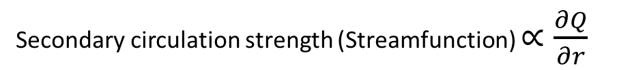
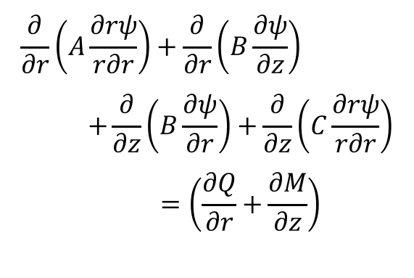
Sawyer Eliassen Equation
Idealized Heating Profile
$$\frac{∂}{∂r}\left(A\frac{∂rψ}{r∂r}\right)+\frac{∂}{∂r}\left(B\frac{∂ψ}{∂z}\right) \\ +\frac{∂}{∂z}\left(B\frac{∂ψ}{∂r}\right)+\frac{∂}{∂z}\left(C\frac{∂rψ}{r∂r}\right) \\ =\left(\frac{∂Q}{∂r}+\frac{∂M}{∂z}\right)$$
Secondary circulation strength (Streamfunction) $∝\frac{∂Q}{∂r}$
Pressure tendency $\frac{∂P}{∂t}∝−\frac{∂Q}{∂z}$

Slide 25
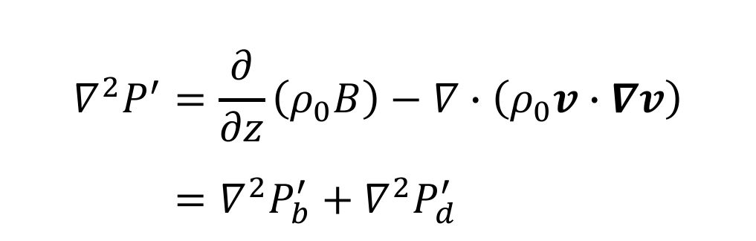
Pressure Perturbation
$$∇^{2}P^{′}=\frac{∂}{∂z}\left(ρ_{0}B\right)−∇∙\left(ρ_{0}v∙∇v\right)$$
$$=∇^{2}P_{b}^{′}+∇^{2}P_{d}^{′}$$

